Slide 1
☺
Student A: My calculus professor was late 16 minutes for his first class, 8 minutes late for the second, and 4 minutes for the third.
Student B: At this rate, he’ll never be in class on time.

Slide 2
Hashing Oswald c
Hash tables are a common approach to the storing/searching problem.
This presentation introduces hash tables.
The class notes are a compilation and edition from many sources. The faculty does not claim intellectual property or ownership of the lecture notes. Thanks to them!

Slide 3
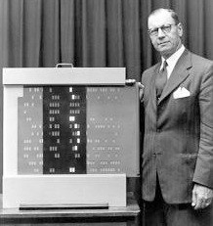
Inventor of Hashing – Hans Peter Luhn
https://medium.com/@dieswaytoofast/the-invention-of-the-hashing-algorithm-600933d7f845

Slide 4
Introduction
Any large information source (data base) can be thought of as a table (with multiple fields), containing information.
For example:
A telephone book has fields name, address and phone number. When you want to find somebody’s phone number, you search the book based on the name field.
A user account on AA-Design, has the fields user_id, password and home folder. You log on using your user_id and password and it takes you to your home folder.

Slide 5
The Search Problem
Find items with keys matching a given search key
Given an array A, containing n keys, and a search key x, find the index i such as x=A[i]
As in the case of sorting, a key could be part of a large record.

Slide 6
Consider some Applications…
Keeping track of customer account information at a bank
Search through records to check balances and perform transactions
Keep track of reservations on flights
Search to find empty seats, cancel/modify reservations
Search engine
Looks for all documents containing a given word

Slide 7
Why do we need hashing?
Many applications deal with lots of data
- Search engines and web pages
There are myriad look ups.
The look ups are time critical.
Typical data structures like arrays and
lists, may not be sufficient to handle
efficient lookups
In general: When look-ups need to
occur in near constant time. O(1)

Slide 8
Why do we need hashing? (cont’d)
Consider the internet(2002 data):
- By the Internet Software Consortium survey at http://www.isc.org/ in 2001, there are 125,888,197 internet hosts, and the number is growing by 20% every six month!
- Using the best possible binary search it takes on average 27 iterations to find an entry.
- By an survey by NUA at http://www.nua.ie/ there are 513.41 million users world wide.

Slide 9
Why do we need hashing?
We need something that can do better than a binary search, O(log N).
We want, O(1).
Solution: Hashing
In fact hashing is used in:
Web searches Spell checkers Databases
Compilers passwords Many others

Slide 10
Dictionary
Dictionary:
Dynamic-set data structure for storing items indexed using keys.
Supports operations Insert, Search, and Delete.
Applications:
Symbol table of a compiler.
Memory-management tables in operating systems.
Large-scale distributed systems.
Hash Tables:
Effective way of implementing dictionaries.
Generalization of ordinary arrays.

Slide 11
Direct-address Tables
Direct-address Tables are ordinary arrays.
Facilitate direct addressing.
Element whose key is k is obtained by indexing into the k^{th} position of the array.
Applicable when we can afford to allocate an array with one position for every possible key.
i.e. when the universe of keys U is small.
Dictionary operations can be implemented to take O(1) time.

Slide 12
Special Case: Dictionaries
Dictionary = data structure that supports mainly two basic operations: insert a new item and return an item with a given key
Queries: return information about the set S:
Search (S, k)
Minimum (S), Maximum (S)
Successor (S, x), Predecessor (S, x)
Modifying operations: change the set
Insert (S, k)
Delete (S, k) – not very often

Slide 13
Dictionary & Search ADTs
Operations
create
destroy
insert
find
delete
Dictionary: Stores values associated with user-specified keys
keys may be any (homogenous) comparable type
values may be any (homogenous) type
implementation: data field is a struct with two parts
Search ADT: keys = values
kim chi
spicy cabbage
kreplach
tasty stuffed dough
kiwi
Australian fruit
insert
kohlrabi
- upscale tuber
find(kreplach)
kreplach
- tasty stuffed dough
Notes:
Dictionaries associate some key with a value, just like a real dictionary (where the key is a word and the value is its definition).
In this example, I’ve stored user-IDs associated with descriptions of their coolness level.
This is probably the most valuable and widely used ADT we’ll hit.
I’ll give you an example in a minute that should firmly entrench this concept.

Slide 14
Implementations So Far
 | unsorted list | sorted array | Trees BST – average AVL – worst case splay – amortized | Array of size n where keys are 0,…,n-1
insert | find+θ(1) | θ(n) | θ(log n)
find | θ(n) | θ(log n) | θ(log n)
delete | find+θ(1) | θ(n) | θ(log n)

Slide 15
Hash Tables: Basic Idea
Use a key (arbitrary string or number) to index directly into an array – O(1) time to access records
A[“kreplach”] = “tasty stuffed dough”
Need a hash function to convert the key to an integer
 | Key | Data
0 | kim chi | spicy cabbage
1 | kreplach | tasty stuffed dough
2 | kiwi | Australian fruit

Slide 16
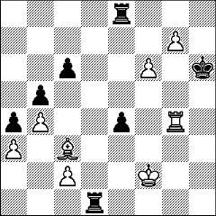
Applications
When log(n) is just too big…
Symbol tables in interpreters
Real-time databases (in core or on disk)
air traffic control
packet routing
When associative memory is needed…
Dynamic programming
cache results of previous computation
f(x) →if ( Find(x) ) then Find(x) else f(x)
Chess endgames
Many text processing applications – e.g. Web
$Status{$LastURL} = “visited”;
Notes:
Before talking about how hashing is done, let’s mention some applications.
When is it important to do lookups in constant time?

Slide 17
Direct Addressing
Assumptions:
Key values are distinct
Each key is drawn from a universe U = {0, 1, . . . , m - 1}
K is a set of all actual keys, where |K| ≤ |U|
Idea:
Store the items in an array, indexed by keys
Direct-address table representation:
An array T[0 . . . m - 1]
Each slot, or position, in T corresponds to a key in U
For an element x with key k, a pointer to x (or x itself) will be placed in location T[k]
If there are no elements with key k in the set, T[k] is empty, represented by NIL

Slide 18
Direct Addressing (cont’d)

Slide 19
Operations
Alg.: DIRECT-ADDRESS-SEARCH(T, k)
return T[k]
Alg.: DIRECT-ADDRESS-INSERT(T, x)
T[key[x]] ← x
Alg.: DIRECT-ADDRESS-DELETE(T, x)
T[key[x]] ← NIL
Running time for these operations: O(1)

Slide 20
Comparing Different Implementations
Implementing dictionaries using:
Direct addressing
Ordered/unordered arrays
Ordered/unordered linked lists
Insert
Search
direct addressing
O(1)
O(1)
ordered array
O(N)
O(lgN)
ordered list
O(N)
O(N)
unordered array
O(1)
O(N)
unordered list
O(1)
O(N)

Slide 21
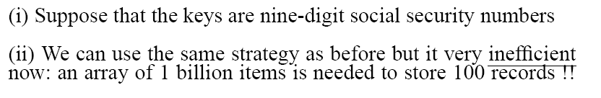
Examples Using Direct Addressing
Example 1:
Example 2:

Slide 22
Hash Tables
Notation:
U – Universe of all possible keys.
K – Set of keys actually stored in the dictionary.
|K| = n.
When U is very large,
Arrays are not practical.
|K| << |U|.
Use a table of size proportional to |K| – The hash tables.
However, we lose the direct-addressing ability.
Define functions that map keys to slots of the hash table.

Slide 23
Hash Tables (cont’d)
When K is much smaller than U, a hash table requires much less space than a direct-address table
Can reduce storage requirements to |K|
Can still get O(1) search time, but on the average case, not the worst case

Slide 24
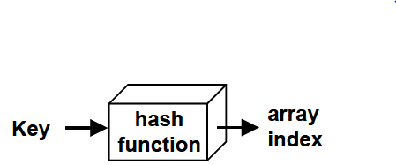
Hashing – An Intro
Hash function h: Mapping from U to the slots of a hash table T[0..m–1].
h : U → {0,1,…, m–1}
With arrays, key k maps to slot A[k].
With hash tables, key k maps or “hashes” to slot T[h[k]].
h[k] is the hash value(hash function) of key k.

Slide 25
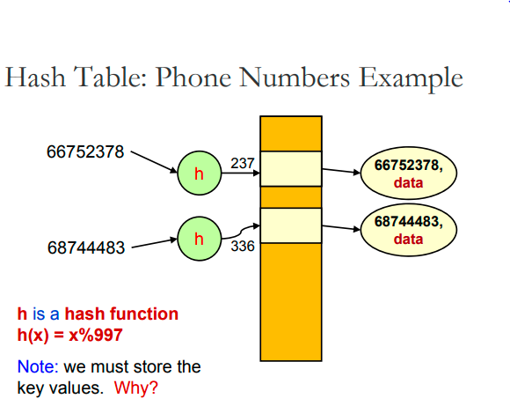
Hash Table – An E.g.

Slide 26
Hashing – An Illustration
0
U
(universe of keys)
h(k₁)
h(k₄)
K
(actual
keys)
k₁
k₄
k₂
h(k₂)=h(k₅)
k₅
k₃
h(k₃)
m–1

Slide 27
Revisit Example 2

Slide 28
Do you see any problems with this approach?
0
U
(universe of keys)
h(k₁)
h(k₄)
K
(actual
keys)
k₁
k₄
k₂
h(k₂)=h(k₅)
k₅
collision
k₃
h(k₃)
m–1

Slide 29
Inserting a New Record
Number 580625685
In order to insert a new record, the key must somehow be converted to an array index.
The index is called the hash value of the key.
[ 0 ]
[ 1 ]
[ 2 ]
[ 3 ]
[ 4 ]
[ 5 ]
[ 700]
Number 281942902
Number 233667136
Number 506643548
. . .
Number 155778322
Notes:
In order to insert a new entry, the key of the entry must somehow be converted to an index in the array. For our example, we must convert the key number into an index between 0 and 700. The conversion process is called hashing and the index is called the hash value of the key.

Slide 30
Inserting a New Record (cont’d)
Number 580625685
Typical way to create a hash value:
(Number mod 701)
What is (580625685 mod 701) ?
[ 0 ]
[ 1 ]
[ 2 ]
[ 3 ]
[ 4 ]
[ 5 ]
[ 700]
Number 281942902
Number 233667136
Number 506643548
. . .
Number 155778322
Notes:
There are many ways to create hash values. Here is a typical approach.
a. Take the key mod 701 (which could be anywhere from 0 to 700).
So, quick, what is (580,625,685 mod 701) ?

Slide 31
Inserting a New Record (cont’d)
Number 580625685
Typical way to create a hash value:
(Number mod 701)
3
What is (580625685 mod 701) ?
[ 0 ]
[ 1 ]
[ 2 ]
[ 3 ]
[ 4 ]
[ 5 ]
[ 700]
Number 281942902
Number 233667136
Number 506643548
. . .
Number 155778322
Notes:
Three.

Slide 32
Inserting a New Record (cont’d)
Number 580625685
The hash value is used for the location of the new record.
[3]
[ 0 ]
[ 1 ]
[ 2 ]
[ 3 ]
[ 4 ]
[ 5 ]
[ 700]
Number 281942902
Number 233667136
Number 506643548
. . .
Number 155778322
Notes:
So, this new item will be placed at location [3] of the array.

Slide 33
Inserting a New Record (cont’d)
The hash value is used for the location of the new record.
[ 0 ]
[ 1 ]
[ 2 ]
[ 3 ]
[ 4 ]
[ 5 ]
[ 700]
Number 281942902
Number 233667136
Number 580625685
Number 506643548
. . .
Number 155778322
Notes:
The hash value is always used to find the location for the record.

Slide 34
Collisions
Number 701466868
Here is another new record to insert, with a hash value of 2.
My hash
value is [2].
[ 0 ]
[ 1 ]
[ 2 ]
[ 3 ]
[ 4 ]
[ 5 ]
[ 700]
Number 281942902
Number 233667136
Number 580625685
Number 506643548
. . .
Number 155778322
Notes:
Sometimes, two different records might end up with the same hash value.

Slide 35
Collisions (cont’d)
Number 701466868
This is called a collision, because there is already another valid record at [2].
When a collision occurs,
move forward until you
find an empty spot.
[ 0 ]
[ 1 ]
[ 2 ]
[ 3 ]
[ 4 ]
[ 5 ]
[ 700]
Number 281942902
Number 233667136
Number 580625685
Number 506643548
. . .
Number 155778322
Notes:
This is called a collision.
When a collision occurs, the insertion process will move forward through the array until an empty spot is found. Sometimes you will have a second collision...

Slide 36
Collisions (cont’d)
Number 701466868
This is called a collision, because there is already another valid record at [2].
When a collision occurs,
move forward until you
find an empty spot.
[ 0 ]
[ 1 ]
[ 2 ]
[ 3 ]
[ 4 ]
[ 5 ]
[ 700]
Number 281942902
Number 233667136
Number 580625685
Number 506643548
. . .
Number 155778322
Notes:
...and a third collision...

Slide 37
Collisions (cont’d)
Number 701466868
This is called a collision, because there is already another valid record at [2].
When a collision occurs,
move forward until you
find an empty spot.
[ 0 ]
[ 1 ]
[ 2 ]
[ 3 ]
[ 4 ]
[ 5 ]
[ 700]
Number 281942902
Number 233667136
Number 580625685
Number 506643548
. . .
Number 155778322
Notes:
But if there are any empty spots, eventually you will reach an empty spot, and the new item is inserted here.

Slide 38
Collisions (cont’d)
This is called a collision, because there is already another valid record at [2].
The new record goes
in the empty spot.
[ 0 ]
[ 1 ]
[ 2 ]
[ 3 ]
[ 4 ]
[ 5 ]
[ 700]
Number 281942902
Number 233667136
Number 580625685
Number 506643548
Number 701466868
. . .
Number 155778322
Notes:
The new record is always placed in the first available empty spot, after the hash value.

Slide 39
A Quiz
Where would you be placed in this table, if there is no collision? Use Aadhaar number or some other favorite number.
[ 0 ]
[ 1 ]
[ 2 ]
[ 3 ]
[ 4 ]
[ 5 ]
[ 700]
Number 281942902
Number 233667136
Number 580625685
Number 506643548
Number 701466868
. . .
Number 155778322
Notes:
Time for another quiz . . . Did anyone end up with a hash value of 700?
Well, I did. My ID number is 155779023, which has a hash value of 700. (No, not really, but I needed to illustrate another kind of collision.
There is a collision with the last location of the array. In this case, you would circle back to the start of the array, and try location number 0, then 1, .... until you find an empty spot. In this example, I would be inserted at location 0, since that location is empty.

Slide 40
How Can You Hash…
A set of values – (name, birthdate) ?
An arbitrary pointer in C?
An arbitrary reference to an object in Java?

Slide 41
How Can You Hash (cont’d)
A set of values – (name, birthdate) ?
(Hash(name) ^ Hash(birthdate))% tablesize
An arbitrary pointer in C?
((int)p) % tablesize
An arbitrary reference to an object in Java?
Hash(obj.toString())
or just obj.hashCode() % tablesize
What’s this?

Slide 42
Hash Functions
A hash function transforms a key into a table address
What makes a good hash function?
(1) Easy to compute
(2) Approximates a random function: for every input, every output is equally likely (simple uniform hashing)
In practice, it is very hard to satisfy the simple uniform hashing property
i.e., we don’t know in advance the probability distribution that keys are drawn from
Minimize the chance that closely related keys hash to the same slot
Strings such as pt and pts should hash to different slots

Slide 43
Good Hash Function
The best hash function would distribute keys as evenly as possible in the hash table
“Simple uniform hashing”
Maps each key to a (fixed) random number
Idealized gold standard
Simple to analyze
Can be closely approximated by best hash functions

Slide 44
Good Hash Functions (cont’d)
Satisfy the assumption of simple uniform hashing.
Not possible to satisfy the assumption in practice.
Often use heuristics, based on the domain of the keys, to create a hash function that performs well.
Regularity in key distribution should not affect uniformity. Hash value should be independent of any patterns that might exist in the data.
E.g. Each key is drawn independently from U according to a probability distribution P:
∑_{k:h(k) = j} P(k) = 1/m for j = 0, 1, … , m–1.
An example is the division method.

Slide 45
Division Method
Map a key k into one of the m slots by taking the remainder of k divided by m. That is,
h(k) = k mod m
Example: m = 31 and k = 78 ⇒ h(k) = 16.
Advantage: Fast, since requires just one division operation.
Disadvantage: Have to avoid certain values of m.
Don’t pick certain values, such as m=2^{p}
Or hash won’t depend on all bits of k.
Good choice for m:
Primes, not too close to power of 2 (or 10) are good.

Slide 46
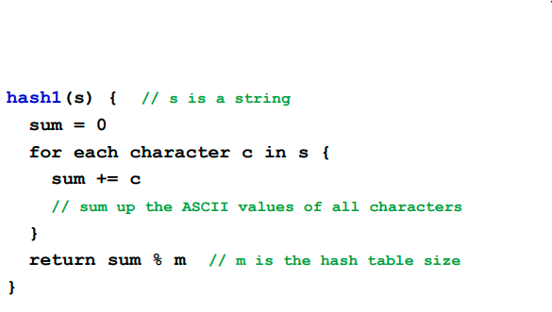
Hashing of Strings

Slide 47
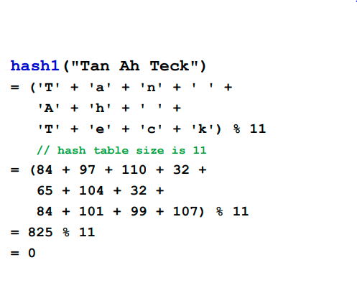
Hashing of Strings : An Example

Slide 48
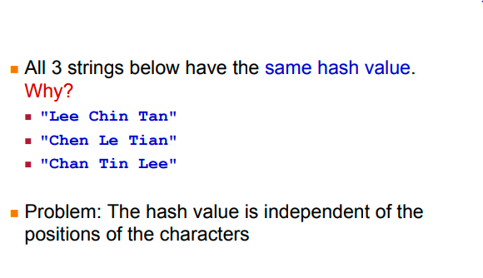
Hashing of Strings : An Example (cont’d)

Slide 49
Issues with Hashing
Multiple keys can hash to the same slot – collisions are possible.
Design hash functions such that collisions are minimized.
But completely avoiding collisions is impossible.
Design collision-resolution techniques.
Search will cost Ө(n) time in the worst case.
However, all operations can be made to have an expected complexity of Ө(1).

Slide 50
Collisions
Two or more keys hash to the same slot!!
For a given set K of keys
If |K| ≤ m, collisions may or may not happen, depending on the hash function
If |K| > m, collisions will definitely happen (i.e., there must be at least two keys that have the same hash value)
Avoiding collisions completely is hard, even with a good hash function

Slide 51
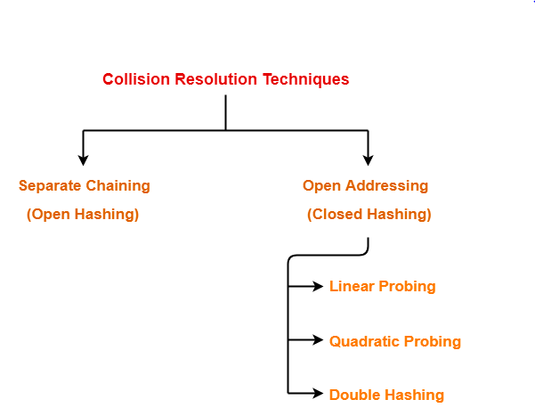
Handling Collisions
We will discuss chaining first, and ways to build “good” functions.

Slide 52
Methods of Collision Resolution
Chaining:
Store all elements that hash to the same slot in a linked list.
Store a pointer to the head of the linked list in the hash table slot.
Open Addressing:
All elements stored in hash table itself.
When collisions occur, use a systematic (consistent) procedure to store elements in free slots of the table.
0
k₁
k₄
k₅
k₂
k₆
k₇
k₃
k₈
m–1

Slide 53
Collision Resolution by Chaining
0
U
(universe of keys)
h(k₁)=h(k₄)
X
k₁
k₄
K
(actual
keys)
k₂
k₆
X
h(k₂)=h(k₅)=h(k₆)
k₅
k₈
k₇
k₃
X
h(k₃)=h(k₇)
h(k₈)
m–1

Slide 54
Collision Resolution by Chaining (cont’d)
0
U
(universe of keys)
k₁
k₄
k₁
k₄
K
(actual
keys)
k₂
k₆
k₅
k₂
k₆
k₅
k₈
k₇
k₃
k₇
k₃
k₈
m–1

Slide 55
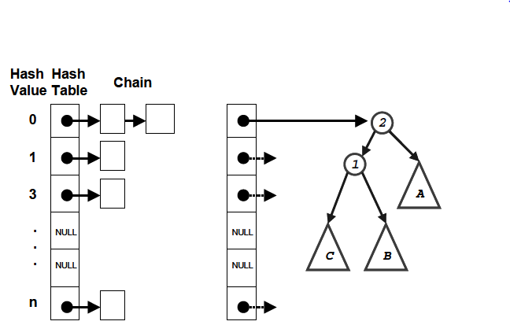
Chaining using Linked Lists / Trees

Slide 56
Insertion in Hash Tables
Alg.: CHAINED-HASH-INSERT(T, x)
insert x at the head of list T[h(key[x])]
Worst-case running time is O(1)
Assumes that the element being inserted isn’t already in the list
It would take an additional search to check if it was already inserted

Slide 57
Deletion in Hash Tables
Alg.: CHAINED-HASH-DELETE(T, x)
delete x from the list T[h(key[x])]
Need to find the element to be deleted.
Worst-case running time:
Deletion depends on searching the corresponding list

Slide 58
Searching in Hash Tables
Alg.: CHAINED-HASH-SEARCH(T, k)
search for an element with key k in list T[h(k)]
Running time is proportional to the length of the list of elements in slot h(k)

Slide 59
Load Factor of a Hash Table
Load factor of a hash table T:
α = n/m
n = # of elements(keys) stored in the table
m = # of slots in the table = # of linked lists
α encodes the average number of elements stored in a chain
α can be <, =, > 1
T
0
chain
chain
chain
chain
m - 1

Slide 60
Analysis on Chained-Hash-Search
Load factor α=n/m = average keys per slot.
m – number of slots.
n – number of elements stored in the hash table.
Worst-case complexity: Θ(n) + time to compute h(k).
Average depends on how h distributes keys among m slots.
Assume
Simple uniform hashing.
Any key is equally likely to hash into any of the m slots, independent of where any other key hashes to.
O(1) time to compute h(k).
Time to search for an element with key k is Θ(|T[h(k)]|).
Expected length of a linked list = load factor = α = n/m.

Slide 61
Expected Cost of a Successful Search
Theorem:
A successful search takes expected time Θ(1+α).
Proof:
The probability that a list is searched is proportional to the number of elements it contains.
Assume that the element being searched for is equally likely to be any of the n elements in the table.
The number of elements examined during a successful search for an element x is 1 more than the number of elements that appear before x in x’s list.
These are the elements inserted after x was inserted.
Goal:
Find the average, over the n elements x in the table, of how many elements were inserted into x’s list after x was inserted.

Slide 62
Expected Cost of an Unsuccessful Search
Theorem:
An unsuccessful search takes expected time Θ(1+α).
Proof:
Any key not already in the table is equally likely to hash to any of the m slots.
To search unsuccessfully for any key k, need to search to the end of the list T[h(k)], whose expected length is α.
Adding the time to compute the hash function, the total time required is Θ(1+α).

Slide 63
Analysis of Search in Hash Tables
If m (# of slots) is proportional to n (# of elements in the table):
n = O(m)
α = n/m = O(m)/m = O(1)
⇒ Searching takes constant time on average

Slide 64
Collision with Chaining - Discussion
Choosing the size of the table
Small enough not to waste space
Large enough such that lists remain short
Typically 1/5 or 1/10 of the total number of elements
How should we keep the lists: ordered or not?
Not ordered!
Insert is fast
Can easily remove the most recently inserted elements

Slide 65
Collision with Chaining - Discussion (cont’d)
Advantages
- Insertion can be carried out at the head of
the list at the index
- The array size is not a limiting factor on the
size of the table
Disadvantages
- Memory overhead incurred if the table size
is small.

Slide 66
Analysis of Hashing with Chaining: Worst Case
How long does it take to search for an element with a given key?
Worst case:
All n keys hash to the same slot
Worst-case time to search is Θ(n), plus time to compute the hash function
T
0
chain
m - 1

Slide 67
Open Addressing I: Linear probing: Inserting a key
Idea: when there is a collision, check the next available position in the table (i.e., probing)
h(k,i) = (h₁(k) + i) mod m
i=0,1,2,...
First slot probed: h₁(k)
Second slot probed: h₁(k) + 1
Third slot probed: h₁(k)+2, and so on
Can generate m probe sequences maximum, why?
probe sequence: < h1(k), h1(k)+1 , h1(k)+2 , ....>
wrap around

Slide 68
Linear probing: Searching for a key
Three cases:
(1) Position in table is occupied with an element of equal key
(2) Position in table is empty
(3) Position in table occupied with a different element
Case 2: probe the next higher index until the element is found or an empty position is found
The process wraps around to the beginning of the table
0
h(k₁)
h(k₄)
h(k₂) = h(k₅)
h(k₃)
m - 1

Slide 69
Linear probing: Deleting a key
Problems
Cannot mark the slot as empty
Impossible to retrieve keys inserted after that slot was occupied
Solution
Mark the slot with a sentinel value DELETED (called tombstone)
The deleted slot can later be used for insertion
Searching will be able to find all the keys
https://opendsa-server.cs.vt.edu/ODSA/Books/CS3/html/HashDel.html
0
m - 1

Slide 70
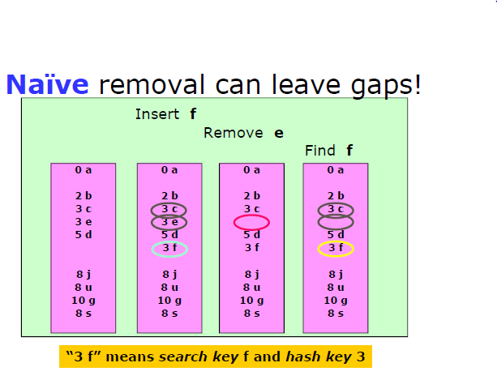
Linear probing: Deleting a key

Slide 71
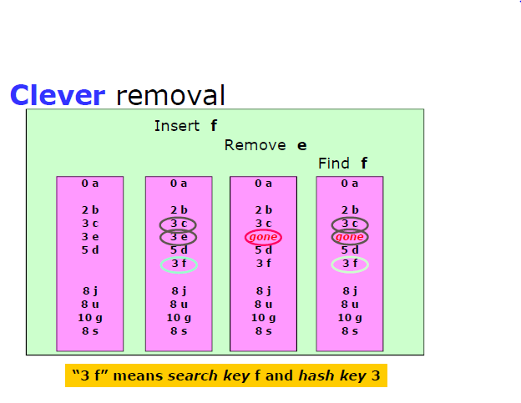
Linear probing: Deleting a key (cont’d)

Slide 72
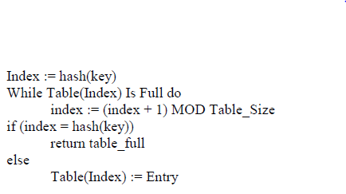
Linear Probing Pseudocode
If the current location is used, try the next table location
Lookups walk along table until the key or an empty slot is found
Uses less memory than chaining. (Don’t have to store all those links)
Slower than chaining. (May have to walk along table for a long way.)
Deletion is more complex. (Either mark the deleted slot or fill in the slot by shifting some elements down.)

Slide 73
Linear Probing - Disadvantages
The main problem with linear probing is clustering, many consecutive elements form groups and it starts taking time to find a free slot or to search an element.

Slide 74
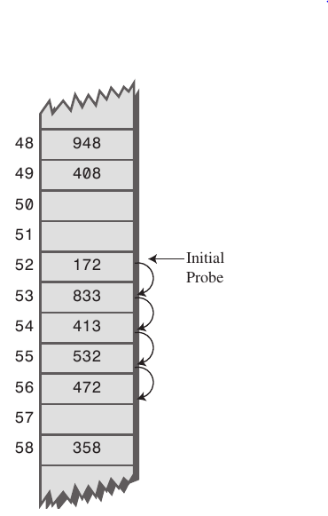
Primary Clustering Problem
Primary Clustering is the tendency for a collision resolution scheme such as linear probing to create long runs of filled slots near the hash position of keys.
If the primary hash index is x, subsequent probes go to x+1, x+2, x+3 and so on, this results in Primary Clustering.
Once the primary cluster forms, the bigger the cluster gets, the faster it grows. And it reduces the performance.

Slide 75
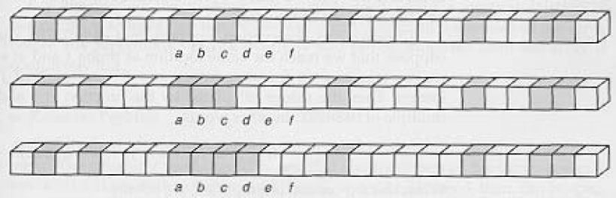
Primary Clustering Problem (cont’d)
Some slots become more likely than others
Long chunks of occupied slots are created
⇒ search time increases!!
initially, all slots have probability 1/m
Slot b:
2/m
Slot d:
4/m
Slot e:
5/m

Slide 76
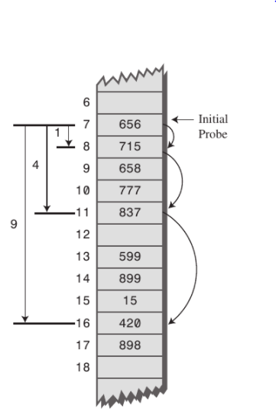
Secondary Clustering in Hashing
Secondary Clustering is the tendency for a collision resolution scheme such as quadratic probing to create long runs of filled slots away from the hash position of keys.
If the primary hash index is x, probes go to x+1, x+4, x+9, x+16, x+25 and so on, this results in Secondary Clustering.
Secondary clustering is less severe in terms of performance hit than primary clustering, and is an attempt to keep clusters from forming by using Quadratic Probing. The idea is to probe more widely separated cells, instead of those adjacent to the primary hash site.

Slide 77
Terminology Alert!
“Open Hashing”
equals
“Separate Chaining”
“Closed Hashing”
equals
“Open Addressing”
Weiss

Slide 78
Open Addressing II: Quadratic Probing
f(i) = i²
Main Idea: Spread out the search for an empty slot – Increment by i² instead of i
Probe sequence:
0th probe = h(k) mod TableSize
1th probe = (h(k) + 1) mod TableSize
2th probe = (h(k) + 4) mod TableSize
3th probe = (h(k) + 9) mod TableSize
. . .
i^{th} probe = (h(k) + i²) mod TableSize
Less likely to encounter Primary Clustering
f(i+1) = f(i) + 2i + 1
Notes:
Add a function of I to the original hash value to resolve the collision.
Less likely to encounter primary clustering, but could run into secondary clustering.
Although keys that hash to the same initial location will still use the same sequence of probes (and conflict with each other).
How big to make hash table? Lambda = ½, (hash table is twice as big as the number of elements expected.)
Note: (i +1)² – i² = 2i + 1 Thus, to get to the NEXT step, you can add 2* current value of i plus one.

Slide 79
Quadratic Probing – e.g. 1 try!
0
1
2
3
4
5
6
7
8
9
Insert:
89
18
49
58
79

Slide 80
Quadratic Probing – e.g. 2 try!
insert(76)
76%7 = 6
insert(40)
40%7 = 5
insert(48)
48%7 = 6
insert(5)
5%7 = 5
insert(55)
55%7 = 6
0
48
1
insert(47)
47%7 = 5
But…
2
5
0: 5
1: 6
4: 2
9: 0
16: 0
25: 2
Never finds spot!
3
55
4
5
40
6
76
Notes:
And, it works reasonably well.
Here it does fine until the table is more than half full.
Let’s take a closer look at what happens when the table is half full.

Slide 81
Quadratic Probing e.g. 3
insert(14)
14%7 = 0
insert(8)
8%7 = 1
insert(21)
21%7 =0
insert(2)
2%7 = 2
0
14
0
14
0
14
0
14
1
1
8
1
8
1
8
2
2
2
2
2
3
3
3
3
4
4
4
21
4
21
5
5
5
5
6
6
6
6
1
1
3
1
probes:
Notes:
You can see that this works pretty well for an empty table and gets worse as the table fills up.
There’s another problem here. If a bunch of elements hash to the same spot, they mess each other up.
But, worse, if a bunch of elements hash to the same area of the table, they mess each other up! (Even though the hash function isn’t producing lots of collisions!)
This phenomenon is called primary clustering.

Slide 82
Problem With Quadratic Probing
insert(14)
14%7 = 0
insert(8)
8%7 = 1
insert(21)
21%7 =0
insert(2)
2%7 = 2
insert(7)
7%7 = 0
0
14
0
14
0
14
0
14
0
14
1
1
8
1
8
1
8
1
8
2
2
2
2
2
2
2
3
3
3
3
3
4
4
4
21
4
21
4
21
5
5
5
5
5
6
6
6
6
6
probes:
1
1
3
1
??
Notes:
You can see that this works pretty well for an empty table and gets worse as the table fills up.
There’s another problem here. If a bunch of elements hash to the same spot, they mess each other up.
But, worse, if a bunch of elements hash to the same area of the table, they mess each other up! (Even though the hash function isn’t producing lots of collisions!)
This phenomenon is called primary clustering.

Slide 83
Load Factor in Quadratic Probing
Theorem: If TableSize is prime and α ≤ ½, quadratic probing will find an empty slot; for greater α, might not
With load factors near ½ the expected number of probes is empirically near optimal – no exact analysis known
Don’t get clustering from similar keys (primary clustering), still get clustering from identical keys (secondary clustering)
Notes:
That’s actually pretty close to perfect… but there are two problems.
First, we might fail if the load factor is above 1/2.
Second, quadratic probing still suffers from secondary clustering. That’s where multiple keys hashed to the same spot all follow the same probe sequence.
How can we solve that?

Slide 84
Open Addressing III: Double Hashing
f(i) = i * g(k) where g is a second hash function
Probe sequence:
0th probe = h(k) mod TableSize
1th probe = (h(k) + 1 g(k)) mod TableSize
2th probe = (h(k) + 2*g(k)) mod TableSize
3th probe = (h(k) + 3*g(k)) mod TableSize
. . .
i^{th} probe = (h(k) + i*g(k)) mod TableSize
Notes:
So the probe sequence is a function of the key in two different ways – for the original starting location (h(k) AND for the amount of offset you move out each time you have a collision (g(k)). (as opposed to both linear probing and quadratic probing where the offset is independent of the key)
** In choosing g care must be taken so that it never evaluates to 0.
A good choice for g is to choose a prime R < TableSIze and let g(k) = R – (k mod R).
Double Hashing is Safe for λ < 1

Slide 85
Open Addressing III: Double Hashing (cont’d)
Idea: Spread out the search for an empty slot by using a second hash function
No primary or secondary clustering
h_{i}(X) = (Hash₁(X) + i*Hash₂(X)) mod TableSize
for i = 0, 1, 2, …
Good choice of Hash₂(X) can guarantee does not get “stuck” as long as α < 1
Integer keys: Hash₂(X) = R – (X mod R) where R is a prime smaller than TableSize

Slide 86
Double Hashing: Example 1
h₁(k) = k mod 13
h₂(k) = 1+ (k mod 11)
h(k,i) = (h₁(k) + i h₂(k) ) mod 13
Insert key 14:
h₁(14,0) = 14 mod 13 = 1
h(14,1) = (h₁(14) + h₂(14)) mod 13
= (1 + 4) mod 13 = 5
h(14,2) = (h₁(14) + 2 h₂(14)) mod 13
= (1 + 8) mod 13 = 9
0
79
69
98
72
50
1
2
3
4
5
6
7
8
9
14
10
11
12

Slide 87
Double Hashing Example 2
h(k) = k mod 7 and g(k) = 5 – (k mod 5)
76
93
40
47
10
55
0
0
0
0
0
0
1
1
1
1
47
1
47
1
47
2
2
93
2
93
2
93
2
93
2
93
3
3
3
3
3
10
3
10
4
4
4
4
4
4
55
5
5
5
40
5
40
5
40
5
40
6
76
6
76
6
76
6
76
6
76
6
76
Probes 1 1 1 2 1 2

Slide 88
Double Hashing Example 3
insert(14)
14%7 = 0
insert(8)
8%7 = 1
insert(21)
21%7 =0
5-(21%5)=4
insert(2)
2%7 = 2
insert(7)
7%7 = 0
5-(21%5)=4
0
14
0
14
0
14
0
14
0
14
1
1
8
1
8
1
8
1
8
2
2
2
2
2
2
2
3
3
3
3
3
4
4
4
21
4
21
4
21
5
5
5
5
5
6
6
6
6
6
probes:
1
1
2
1
??
Notes:
You can see that this works pretty well for an empty table and gets worse as the table fills up.
There’s another problem here. If a bunch of elements hash to the same spot, they mess each other up.
But, worse, if a bunch of elements hash to the same area of the table, they mess each other up! (Even though the hash function isn’t producing lots of collisions!)
This phenomenon is called primary clustering.

Slide 89
Double Hashing Example 3 (cont’d)
insert(14)
14%7 = 0
insert(8)
8%7 = 1
insert(21)
21%7 =0
5-(21%5)=4
insert(2)
2%7 = 2
insert(7)
7%7 = 0
5-(21%5)=4
0
14
0
14
0
14
0
14
0
14
1
1
8
1
8
1
8
1
8
2
2
2
2
2
2
2
3
3
3
3
3
4
4
4
21
4
21
4
21
5
5
5
5
5
7
6
6
6
6
6
probes:
1
1
2
1
4
Notes:
You can see that this works pretty well for an empty table and gets worse as the table fills up.
There’s another problem here. If a bunch of elements hash to the same spot, they mess each other up.
But, worse, if a bunch of elements hash to the same area of the table, they mess each other up! (Even though the hash function isn’t producing lots of collisions!)
This phenomenon is called primary clustering.

Slide 90
Resolving Collisions with Double Hashing
0
1
2
3
4
5
6
7
8
9
Hash Functions:
H(K) = K mod M
H₂(K) = 1 + ((K/M) mod (M-1))
M =
Insert these values into the hash table in this order. Resolve any collisions with double hashing:
13
28
33
147
43

Slide 91
Performance of Double Hashing
(1) Use one hash function to determine the first slot
(2) Use a second hash function to determine the increment for the probe sequence
h(k,i) = (h₁(k) + i h₂(k) ) mod m, i=0,1,...
Initial probe: h₁(k)
Second probe is offset by h₂(k) mod m, so on ...
Advantage: avoids clustering
Disadvantage: harder to delete an element
Can generate m² probe sequences maximum

Slide 92
Analysis of Open Addressing
Like Chaining, the performance of hashing can be evaluated under the assumption that each key is equally likely to be hashed to any slot of the table (simple uniform hashing)
m = Number of slots in the hash table
n = Number of keys to be inserted in the hash table
Load factor α = n/m ( < 1 )
Expected time to search/insert/delete < 1/(1 - α) (For proof, please refer CLRS)
So Search, Insert and Delete take (1/(1 - α)) time

Slide 93
Analysis of Open Addressing (cont’d)
(load factor)
k=0

Slide 94
Re-hashing
If the table is full
Double the size and re-hash everything with a new hashing function

Slide 95
Extendible hashing
Ronald Fagin in 1979
A dynamic hashing method wherein directories, and buckets are used to hash data. It is an aggressively flexible method in which the hash function also experiences dynamic changes.
An approach that tries to make hashing dynamic, i.e. to allow insertions and deletions to occur without resulting in poor performance after many of these operations. Why t
Practically all modern filesystems use either extendible hashing or B-trees. In particular, the Global File System, ZFS, and the SpadFS filesystem use extendible hashinghis is not the case for ordinary hashing?

Slide 96
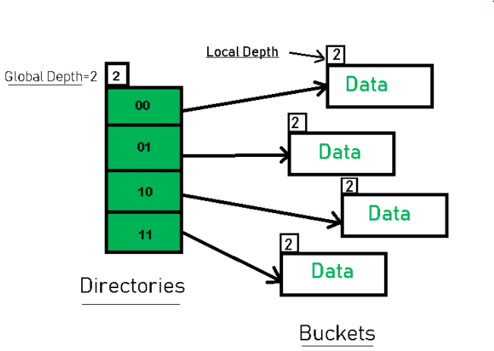
Basic Structure of Extendible Hashing
Directories: The directories store addresses of the buckets in pointers. An id is assigned to each directory which may change each time when Directory Expansion takes place.
Buckets: The buckets are used to hash the actual data.
Ref: https://www.geeksforgeeks.org/extendible-hashing-dynamic-approach-to-dbms/

Slide 97
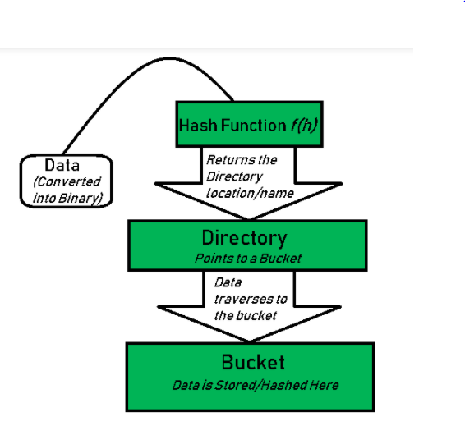
Basic Working of Extendible Hashing

Slide 98
Random hashing
Each element x stored in the hash table comes with a random sequence x0, x1, x2,... where each of the xi is independently and uniformly distributed in {1,... , m}.
As with double hashing, random hashing avoids clustering by making the probe sequence depend on the key.
The probe sequence is generated by the output of a pseudorandom number generator seeded by the key (possibly together with another seed component that is the same for every key, but is different for different tables)

Slide 99
Rehashing
Rehashing means hashing again.
When the load factor increases to more than its pre-defined value (default value of load factor is 0.75), the complexity increases.
To overcome this:
The size of the array is increased (doubled)
and all the values are hashed again and
stored in the new double sized array to
maintain a low load factor and low complexity.
Ref:https://www.cs.odu.edu/~zeil/cs361/web11/website/Lectures/rehashing/page/rehashing.html

Slide 100
Rehashing Example
Separate chaining
h₁(x) = x mod 5 rehashes to h₂(x) = x mod 11
0
1
2
3
4
α =1
25
37 52
83 98
0
1
2
3
4
5
6
7
8
9
10
α =5/11
25
37
83
52
98

Slide 101
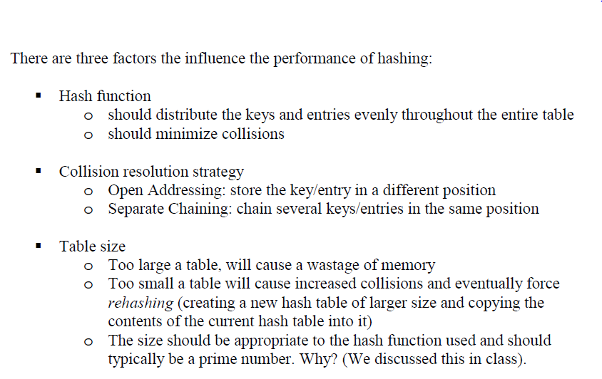
Performance of Hashing

Slide 102
Case Study
Spelling dictionary
50,000 words
static
arbitrary(ish) preprocessing time
Goals
fast spell checking
minimal storage
Practical notes
almost all searches are successful
words average about 8 characters in length
50,000 words at 8 bytes/word is 400K
pointers are 4 bytes
there are many regularities in the structure of English words
Why?
Notes:
Alright, let’s move on to the case study.
Here’s the situation.
Why are most searches successful?
Because most words will be spelled correctly.

Slide 103
Solutions
Solutions
sorted array + binary search
separate chaining
open addressing + linear probing

Slide 104
Storage
Assume words are strings and entries are pointers to strings
Array +
binary search
Closed hashing
Separate chaining
…
n pointers
table size + 2n pointers = n/λ + 2n
n/λ pointers
Notes:
Notice that all of these use the same amount of memory for the strings.
How many pointers does each one use?
N for array. Just store a pointer to each string.
n (pointer to each string) + n/lambda (null pointer ending each list). Note, I’m playing a little game here; without an optimization, this would actually be 2n + n/lambda.
N/lambda.

Slide 105
Puzzler
Suppose you have a HUGE hash table, that you often need to re-initialize to “empty”. How can you do this in small constant time, regardless of the size of the table?

Slide 106
Databases
A database is a set of records, each a tuple of values
E.g.: [ name, ss#, dept., salary ]
How can we speed up queries that ask for all employees in a given department?
How can we speed up queries that ask for all employees whose salary falls in a given range?

Slide 107
Few References
https://www.comp.nus.edu.sg/~stevenha/cs1020e/lectures/L11%20-%20Hashing.pdf
http://web.mit.edu/16.070/www/lecture/hashing.pdf

